Slide 1
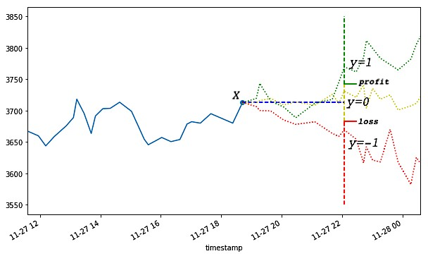
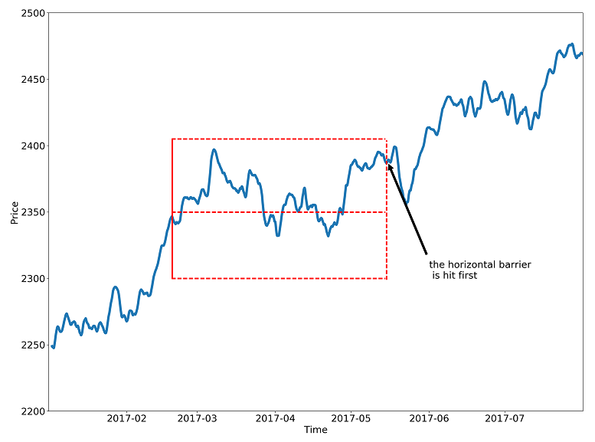
Step 1: which bar to use?
Optional: get trading side
Step 3: define upper and lower band
Label data: - touch upper: 1 - touch lower: -1 - touch vertical: 0 or with side info, label 0 (Non profitable) or 1 (profitable).
Step 2: define T0 event
Event: 如突破
Step 4: define window size

Slide 2
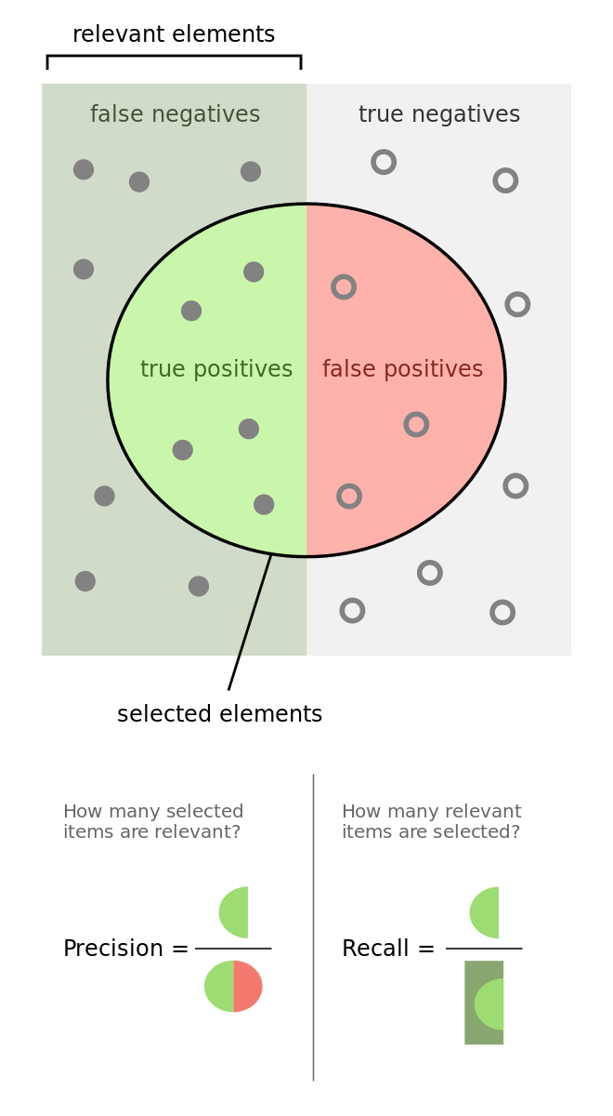
Meta Label
The central idea is to create a secondary ML model that learns how to use the primary exogenous model. This leads to improved performance metrics, including: Accuracy, Precision, Recall, and F1-Score.
The ML algorithm will be trained to decide whether to take the bet or pass, a purely binary prediction. When the predicted label is 1, we can use the probability of this secondary prediction to derive the size of the bet, where the side (sign) of the position has been set by the primary model.
Meta-labeling is particularly helpful when you want to achieve higher F1-scores. First, we build a model that achieves high recall, even if the precision is not particularly high. Second, we correct for the low precision by applying meta-labeling to the positives predicted by the primary model.

Slide 3
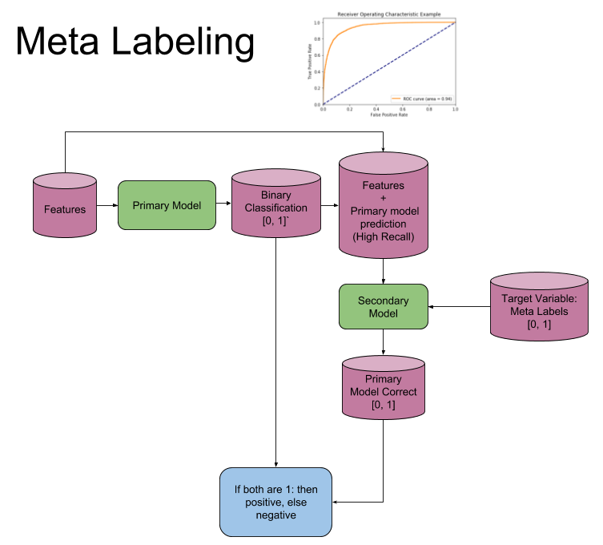
Meta Label
New feature: prediction from primary model
Meta Label: prediction & actual, true positive or true negative then label it as 1(i.e. the model is correct), else 0 (the model in incorrect) meta_model.fit(x=new_features, y=meta_labels)

Slide 4
Hyper parameters & Features (Human Knowledge)
What bar to use?
How to define a valid T0 event? T0 event is like a precondition, based on which the probability of profitable trade can be increased (instead of randomly pick a starting point)?
How to define upper and lower band?
How to define the length of the horizon?
What strategy to trade? E.g. for MA cross over – window size etc.

Slide 5
Some thoughts
ML model is not important compared with features/data (garbage in garbage out)
Good Features and T0 Event requires a lot of knowledge (not just financial related)
Based on this framework, we can try huge amount of combination
It’s just from the first 3 chapters of adv_fin_ml

